Slide 1
DEVONSHIRE WARD STUDENT HANDBOOK. GENERAL SURGERY
By Leanne Jones & Yasmin Brocklehurst (Devonshire ward LEM)
January 2024

Slide 2
Welcome to Devonshire!
Devonshire is a ward specialising in general surgery, we see a variety of different conditions on the ward. This means LOTS of learning opportunities!
Take time to look at your handover sheet and identify learning opportunities that you might like to observe and participate in – take your learning into your own hands!
Ward LEM: Leanne Jones & Yasmin Brocklehurst.

Slide 3
What is expected of you as the student..

Slide 4
Remember the 6C’s in nursing:
State what year you are in and ask for their NHS Email address
Take control of your own learning- Tell the member of staff you are working with what you want to achieve on that shift, e.g., any procedures that you want to observe or proficiencies that you need to cover- be proactive
Look at your handover sheet and highlight anything you don’t understand or want to know more about
Medication rounds are very important but don’t forget the importance of basic patient care too.
Show enthusiasm with Observations- they tell us a lot about our patients and their condition!
Learn about commonly used medications within surgery- Antiemetic, analgesics, antibiotics and anti-coagulants

Slide 5
Remember the 6C’s in nursing:
If you don’t know what a medication is used for, at least know where to look- BNF or MEDUSA for injectable medications
Due to ward acuity; you may not always be able to participate in all medication rounds. Use this time to experience other aspects of patient care.
3rd year students, take care of your own bay of patients; do not leave this until your management placement- You can do it!!
Familiarise yourself with documentation used on the ward- Care plans, risk assessments, fluid balance charts, stool chart
Through your placement choose a few surgical conditions that you are interested in and investigate them in more depth
Please adhere to the correct dress code
Breaks should be taken at the same time as the nurse leading your team unless told otherwise

Slide 6
Remember the 6C’s in nursing:
If you need to change a shift or leave early, please see the nurse in charge, one of the ward sisters or an L.E.M
You are part of the Devonshire team whilst on placement and your contribution is valued
Your L.E.M is Leanne Jones/ Yasmin Brocklehurst

Slide 7
Members of the multidisciplinary team
Matron
Doctors
Sisters/ Charge Nurses
Nurses
Health care assistants
Nursing associates
Occupational therapists
Physiotherapists
Speech and language therapists
Stoma team

Slide 8
Members of the multidisciplinary team
Breast team
Palliative care team
House keepers
Domestics
Patient service assistant
Receptionist
Pharmacist
Tissue viability nurse
Upper G.I nurses

Slide 9
Members of the multidisciplinary team
Upper GI
Colorectal
ENT/ max fax
Gynae
Breast
Urology
Vascular

Slide 10
Common diagnostics test for surgery include:
X-ray An X-ray is a quick and painless procedure commonly used to produce images of the inside of the body
USS- Ultrasound scan An ultrasound scan, sometimes called a sonogram, is a procedure that uses high-frequency sound waves to create an image of part of the inside of the body
MRCP A magnetic resonance cholangiopancreatography scan is a non-invasive medical scanning method that uses radio waves and a magnetic field
ERCP Endoscopic retrograde cholangiopancreatography is a procedure that combines upper gastrointestinal endoscopy and x-rays to treat problems of the bile and pancreatic ducts

Slide 11
Common diagnostics test for surgery include:
MRI Magnetic resonance imaging is a type of scan that uses strong magnetic fields and radio waves to produce detailed images of the inside of the body
CT scan: A computed tomography scan uses X-rays and a computer to create detailed images of the inside of the body
Blood tests
Sputum samples
Urinalysis

Slide 12
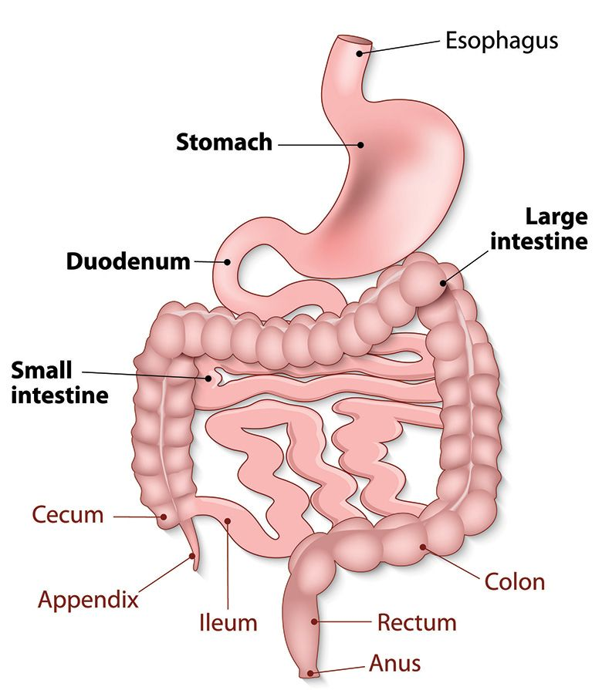
The gastrointestinal tract
Upper gastrointestinal surgery is surgery performed to treat pathologies of the oesophagus, stomach, pancreas, liver, spleen, bile duct and gall bladder

Slide 13
Commonly encountered conditions include..
Pain and inflammation of the stomach and flank area
Gastritis
H-pylori infection
Gastroesophageal reflux disease
Peptic ulcers
Bowel obstructions
Cancers
Diverticulitis
Appendicitis

Slide 14
Common GI surgical procedures include:
Laparoscopic cholecystectomy
Laparoscopic cholecystectomy and bile duct exploration
Endoscopic Retrograde Cholangiopancreatography
Laparoscopic repair of hiatus hernias
Gastroscopy +/- oesophageal stent insertion
Laparoscopic repair of inguinal hernias
Laparoscopic repair of incisional hernias
Open repair of inguinal hernias
Repair of para-umbilical, femoral and epigastric hernias
Laparoscopic staging of tumours Colorectal surgery: - specialises in the diagnosis and treatment of colorectal and anal pathology including bowel cancer , diverticular disease and inflammatory bowel disease

Slide 15
Common upper GI symptoms include
Fatigue
Cramping
Bloating
Gas
Diarrhoea
Constipation
Abdominal pain

Slide 16
Max fax/ ENT

Slide 17
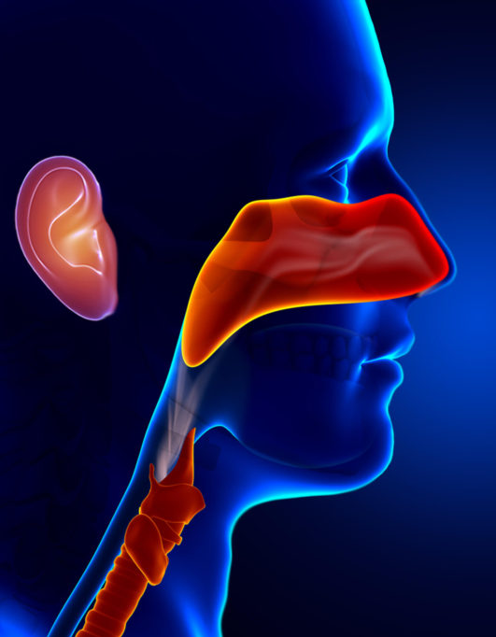
What do ENT specialists do?
The ENT team treat conditions that affect the senses such as hearing and balance disorders or smell and taste problems
You'll also treat patients with conditions that affect their voice, breathing and swallowing as well as those with head and neck tumours
On Devonshire ward, we can treat patients with Tracheostomies and Laryngectomies.

Slide 18
Types of common ENT surgeries
Otology – Treatment of infection, disease and damage to the ear to improve hearing and balance
Rhinology – Treatment of sinus and nasal disorders, including allergy, to relieve pain, ease breathing and improve nasal function
Laryngology – Treatment of infections of the throat and larynx to ease speech and swallowing
Head and neck surgery – away from the main ENT systems, specializing in surgery on cysts, glands such as lymph, salivary, thyroid and parathyroid glands, and head and neck cancers
Facial plastics – this can include aesthetic procedures such as rhinoplasty , pinnaplasty , face lifts or reconstructive such as re-setting the jaw
Paediatrics – there are many ENT conditions, often congenital, that require treatment at a very young age

Slide 19
Types of common ENT surgeries
Insertion of grommets - to allow air to middle ear in cases of chronic middle ear infection to assist hearing
Tonsillectomy - removal of tonsils and/or adenoids to relieve a variety of conditions
Septoplasty - correction of nasal septum to enable clear breathing and prevent obstruction
Endoscopic sinus surgery - minimally invasive surgery for serious cases of inflamed, infected and blocked sinuses
Tracheostomy or “operations on the voice box ” - creation of an alternative airway in the throat for patients having trouble breathing

Slide 20
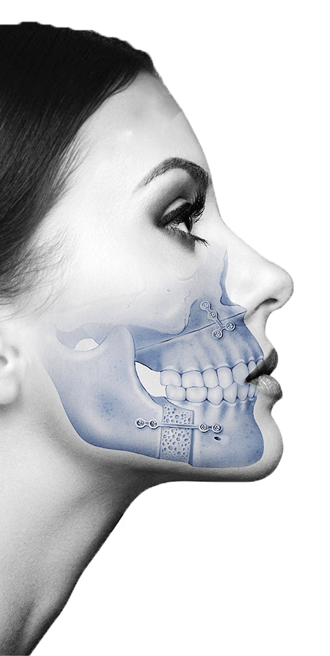
What do Maxillofacial surgeons do?
Misaligned jaws
Impacted wisdom teeth
Oral reconstructive surgery
Cancers of the head and neck
Dental implants

Slide 21
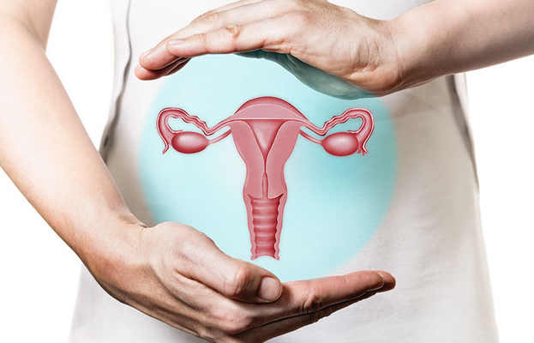
Gynaecology
Laparoscopy and hysteroscopy- laparoscopy is used to examine the abdomen to investigate pelvic pain
Dilatation and curettage - to investigate heavy or irregular periods, or to remove retained products of conception post miscarriage
Hysterectomy- A total hysterectomy involves the removal of the uterus and the cervix
Endometrial ablation
Salpingectomy- removal of the full or part of the fallopian tube
Lap adhesiolysis- To remove scar tissue from disease or previous surgeries

Slide 22
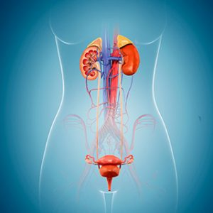
Urology
The organs covered by urology include:
kidneys
ureters
urinary bladder
urethra
Prostate (male)

Slide 23
Urology
Robotic surgery to remove the bladder, kidney or prostate to treat cancer
kidney stone removal/laser fragmentation of kidney and ureteric stones
Cystoscopy
Urostomy- formation of a stoma to divert urine into a bag
vasectomy
Circumcision and scrotal surgery
Cystoscopy: a test that allows your doctor to look at the inside of the bladder and the urethra using a thin, lighted instrument called a cystoscope
Urodynamic: a diagnostic study of pressure in the bladder that can be used in explaining and treating incontinence

Slide 24
Surgical terminology, cheat sheet
'Laparoscopic': Laparoscopy is a type of keyhole surgery used to diagnose and treat conditions. It allows a surgeon to use only small cuts and a camera for procedures inside the tummy or pelvis.
Laparotomy: a surgical incision into the abdominal cavity, usually referred to as 'open surgery'
'..oscopy': The use of a scope (camera) to view parts of the body. i.e, 'Colonoscopy'
'..itis': Infection and inflammation. i.e an infected pancreas is referred to as 'Pancreatitis'.
..'Ostomy': surgery to create an opening (stoma) from an area inside the body to the outside, i.e 'Colostomy', 'Ileostomy', 'Urostomy'

Slide 25
Commonly used abbreviations
CBD- Catheter bag drainage/ common bile duct
E&D- Eating and drinking
NBM- Nil by mouth
O.T- Occupational therapy
P.T- Physiotherapy
CA- Cancer
O2- Oxygen
D/C- Discharge
CCOT- Critical care outreach team
ITU- Intensive care unit

Slide 26
Commonly used abbreviations
HDU- High dependency unit
DNAR- Do not attempt resuscitation
TWOC- Trial without catheter
EST- Enhanced support team
FF- Free fluids
CFF- Clear free fluids
IVAB- Intravenous antibiotics
VRII- Variable rate insulin infusion
HTN- Hypertension
VBG- Venous blood gas

Slide 27
Commonly used abbreviations
ABG- Arterial blood gas
USS- ultrasound scan/
MFFD- Medically fit for discharge
TPN- Total parental nutrition
PICC- Peripheral inserted central catheter
CVP- Central venous pressure line
PEG- Percutaneous endoscopic gastrostomy
RIG- Radiologically inserted gastrostomy
T2- Type 2 diabetic
T1- Type 1 diabetic

Slide 28
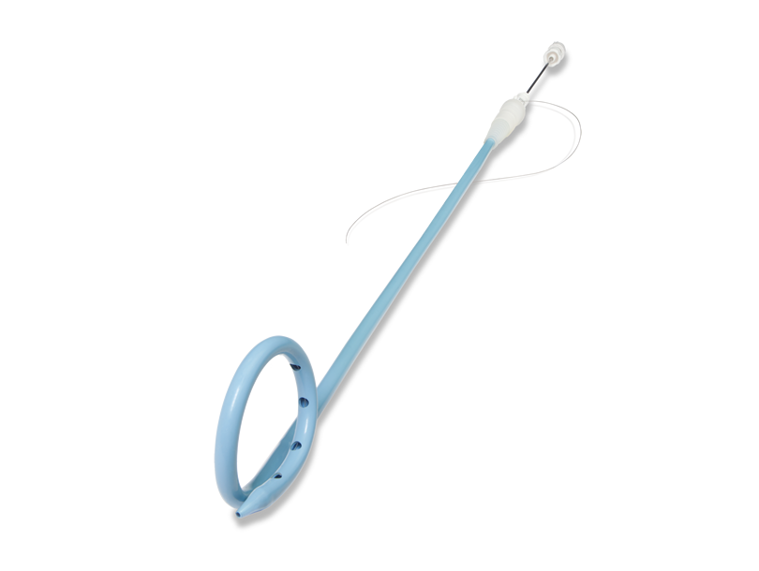
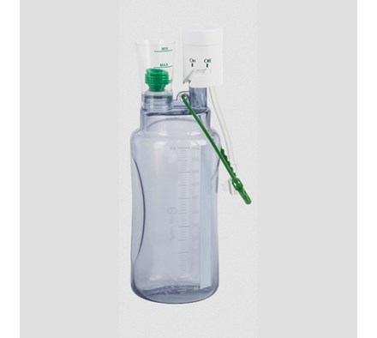
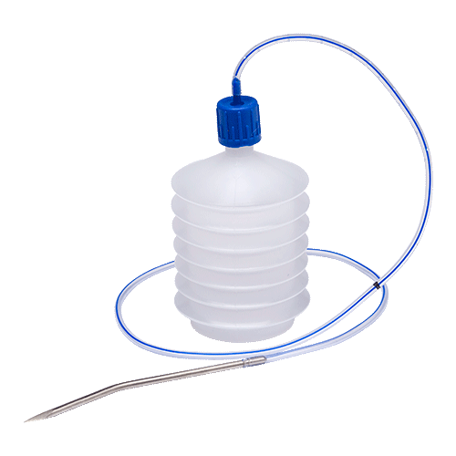
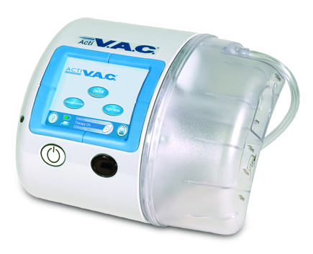
Types of Drains:
Robinson Drain
Pigtail drain
Redivac drain
Corrugated drain
Minivac drain
Vacuum assisted closure

