Slide 1
Symptom control in palliative care
Lead clinical nurse specialist in supportive care

Slide 2
Hospital Palliative Care team
The Supportive Care Team operates weekdays 08:00-16:00
Consultants
Dr Caroline Facey
SpR
Dr Stanley Cousins
Lead Clinical Nurse Specialists
Sharon Thorpe-Roberts
Sharon Hill
Nancy Poulton
Charli Liszka
End of Life Senior Matron
Beth Clarke
Clinical Nurse Specialist
Chelsie Smith

Slide 3
In-patients - Palliative
When to Refer
Patients with a palliative diagnosis that have Complex physical, psychological, social, financial and spiritual distress that cannot be managed by the ward.
Emotional support for patients/carers and family.
Support surrounding advanced care planning.
How to refer
Refer via careflow, these referrals will be triaged. Urgent referrals are seen within 1 working day, non-urgent referrals are seen with 1-2 working days.
For urgent referrals bleep 099 and a member of the team will be in contact to discuss the referral ASAP.
If specialist advice needed OOH’s contact Palliative SPR via Switchboard.

Slide 4
Cancer of Unknown Primary (CUP)
When to Refer
Patients who have an unexpected finding of metastatic disease with no identified primary.
CUP MDT is held on a Monday at 14.00 (not on bank holidays)
CUP clinic Tuesday AM
How to refer
Via the intranet; cancer services – electronic MDT referral
If requires urgent symptom management support, please bleep 099

Slide 5
Symptom management, Psychological support and Advanced care planning.
For patients that do not yet need input from Ashgate community CNS team but requiring some palliative care support. Non-complex support can be provided by site specific teams.
Patients highlighted by oncologist as Best Supportive Care that are requiring ongoing palliative care support.
Clinic held via telephone with some face to face appointments available.
Can refer into clinic by emailing CRHFT.supportivecareclinic@nhs.net
Supportive Care Clinic

Slide 6
Principles of palliative care
Provides relief from pain and other distressing symptoms;
Affirms life and regards dying as a normal process;
Neither to hastens or postpones death;
Integrates the psychological and spiritual aspects of care
Supports patients to live as actively as possible until death
Offers support to help the family cope during the patient's illness and in their own bereavement
Team approach to address the needs of patients and families
Enhances quality of life, and may positively influence the course of illness; and is applicable early in the course of illness

Slide 7
JIC medications
Medication | Dose | Frequency | Route | Uses
Morphine Sulphate | 2.5—5mg | 1-2 hourly | S/C | Pain SOB
Oxycodone | 2.5—5mg | 1-2 hourly | S/C | Pain SOB
Alfentanil | 250—500mcg | 1-2 hourly | S/C | Pain SOB
Haloperidol | 1.5mg—2.5mg | 1-2 hourly | S/C | Nausea/vomiting Delirium
Midazolam | 2.5mg | 1-2 hourly | S/C | Terminal agitation Seizures Catastrophic bleed SOB
Hyoscine Butylbromide | 20mg | 1-2 hourly | S/C | Secretions Colic

Slide 8
Morphine Sulphate

Slide 9
Indications for use | Pain Cough Breathlessness
Contra-indications | None if titrated carefully against a patients pain
Time to Peak effect | <60 min PO (immediate release 20 min IV 30-60 min IM 50-90 min S/C
Duration of action | 3-6 hours 12-24 hours (modified release)
Cautions | Renal impairment Severe hepatic impairment
Undesirable effects | Nausea and vomiting Sedation Delirium Constipation Neurotoxicity Sweating Urinary retention Pruritis Gastric stasis myoclonus
Doses | Usual starting dose of 2.5 – 5mg S/C PRN If already on an opioid this will need to be taken into account when selecting PRN doses.

Slide 10
Oxycodone

Slide 11
Indications for use | Pain Alternative if intolerant to other strong opioids Restless leg syndrome
Contra-indications | Moderate to severe hepatic impairment Otherwise none absolute if titrated carefully against a patients pain
Onset of action | 20-30 min PO
Duration of action | 4-6 hours 12 hours modified release
Cautions | Renal impairment mild hepatic impairment
Undesirable effects | Nausea and vomiting Sedation Delirium Constipation Neurotoxicity Sweating Urinary retention Pruritis Gastric stasis myoclonus
Doses | Usual starting dose of 2.5 – 5mg S/C PRN If already on an opioid this will need to be taken into account when selecting PRN doses.

Slide 12
Alfentanil

Slide 13
Indications for use | Pain An alternative in cases of intolerance to other strong opioids, particularly in renal failure
Contra-indications | None absolute if titrated carefully against patients' pain
Onset of action | 0.75 min
Duration of action | 30 min
Cautions | Hepatic or renal impairment
Undesirable effects | Nausea and vomiting Sedation Delirium Constipation Neurotoxicity Sweating Urinary retention Pruritis Gastric stasis myoclonus
Doses | Usual starting dose of 250-500mcg S/C PRN If already on an opioid this will need to be taken into account when selecting PRN doses.

Slide 14
Haloperidol

Slide 15
Indications for use | Psychosis Nausea and Vomiting Intractable hiccup Delirium Terminal agitation
Contra-indications | Parkinson's disease Lewy body dementia Significant cardiac disorders Recent MI Uncompensated heart failure
Onset of action | 10-15 min S/C 1 hour PO
Duration of action | Up to 24 hours, sometimes longer
Cautions | Dementia Epilepsy Renal and hepatic impairment Hyperthyroidism Cardiac disease
Undesirable effects | Extrapyramidal effects Altered LFTs Dizziness Sedation Depression Visual disturbances Hypotension Acute dopamine depletion Prolongation of QT interval
Doses | 1.5mg-2.5mg SC PRN Smaller doses in renal impairment

Slide 16
Midazolam

Slide 17
Indications for use | Seizures Terminal agitation Breathlessness Anxiety and panic disorders Sedation (terminal bleed)
Contra-indications | Unless in the imminently dying Acute severe pulmonary insufficiency Untreated sleep apnoea Severe hepatic impairment
Onset of action | 30 min S/C <30 min buccal
Duration of action | 1-4 hours
Cautions | Chronic respiratory disease History of substance abuse
Undesirable effects | Drowsiness Impaired psychomotor skills Reduced independence Cognitive impairment Agitation and aggression Physical and psychological dependence
Doses | 2.5mg S/C PRN

Slide 18
Hyoscine Butylbromide

Slide 19
Indications for use | Secretions Colic Smooth muscle spasm Inoperable bowel obstruction
Contra-indications | Glaucoma Tachycardia
Onset of action | 10 min S/C 1-2 hour PO
Duration of action | <2 hours
Cautions | Cardiac disease
Undesirable effects | Tachycardia Drowsiness Cognitive impairment Delirium Restlessness Agitation Heartburn Constipation Retention Flushing
Doses | 20mg S/C PRN

Slide 20
Common symptoms
Weakness and lethargy 95%
Pain 80%
Loss of appetite/anorexia 80%
Constipation 65%
Breathlessness 60%
Insomnia 60%
Dry mouth 50%
Nausea and vomiting 50%
Anxiety 40%
Cough 30%
Confusion 30%

Slide 21
Breathlessness
“A subjective sensation of breathlessness which occurs when the demand for oxygen is greater than the body’s ability to supply it” (Regnard, C & Ahmedzai, S 1990)
“a feeling of suffocation or filling up or drowning” (Brown et al, 1986)

Slide 22
Up to 78% pts with advanced cancer
Over 50% pts with end stage AIDS, COPD, heart disease & renal disease
Not limited to those with cancer or respiratory disease
CCF, COPD & advanced neurological or muscular disease may have dyspnoea as main symptom
Complex distressing symptom
- Incorporates physical, psychological, spiritual & social factors
Often poorly understood
Identified as most difficult symptom to alleviate
Effect on patients' quality of life can be devastating

Slide 23
Emotions associated with breathlessness
Panic 40%
Feeling of impending death 31%
Fear/fright 31%
Anxiety 23%
Anger 15%
Helplessness 10%

Slide 24
“Will I choke to death?”
“I feel as if I’m suffocating”
“Will I stop breathing if I go to sleep?”
Panic in breathlessness

Slide 25
Fatigue
Fear and anxiety
Depression
Isolation
Inactivity
Sleep disturbances
Inability to perform Activities of Daily Living
Diminished muscle tone- Decreased exercise tolerance
Deterioration of physical health
Impact of breathlessness

Slide 26
Breathlessness in advanced cancer can be divided into 3 types:
Breathlessness on exertion (prognosis = months-to-years)
Breathlessness at rest (prognosis = weeks-to-months)
Terminal breathlessness (prognosis = days-to-weeks)

Slide 27
Breathlessness management
Non-pharmacological management
- Position, environment, companionship/ care support
- Fan therapy – central facing, try before oxygen therapy
- Oxygen therapy – nasal cannuli (? Oxygen condenser)
Pharmacological management
- low dose morphine (2.5mg oramorph liquid 4 hrly)
- Benzodiazepines (regular Diazepam/PRN
Lorazepam 0.5 -1mg)
- Bronchodilators – nebulizer/volumatic
- Steroid therapy (Dexamethasone – useful in lung metastases, bronchospasm & tumour mass
Coping strategies
- Goal setting/adaptation - maximise quality of life
- Breathing retraining/control techniques – taking control
Cognitive strategies
- Explore understanding – practical advice and support & information giving
- Anxiety management – relaxation/distraction techniques

Slide 28
Mouth care
For a dry mouth:
Keep lips moist,
Regular fluids,
Mouth washes,
Suck ice,
De-mister,
Pineapple,
Citrus/gum
Oral thrush “Candida”
White plaques on tongue cheeks soft palate
Mouth sore
Treatment: Nystatin drops/lozenges on CLEAN MOUTH
Daktarin/Ketoconazole
Ulcers
Can be due to poor oral care, infection, debility
Good mouth care, moisture,
Nystatin
Bonjela/Orabase

Slide 29
Mouthcare in final days of life
Same principles apply.
Frequency important.
Anticipate
Hydration debate!
Be creative!!!

Slide 30
Nausea and vomiting
Size of the problem…
Prevalence of nausea in all pts with advanced cancer is 20-30%
This rises to 70% in last week of life
20% of patients with advanced cancer develop vomiting
N & V is highest in gynaecology pts (42%)
Advanced stomach cancer 36%
30% taking morphine have nausea in the 1st week of taking
NAUSEA
Unpleasant sensation in upper G.I.T. accompanied by the urge to vomit.
RETCHING
Rhythmic, laboured, spasmodic movements of the diaphragm & abdominal muscles. Usually accompanied by nausea & may precede or alternate with vomiting.
VOMITING
Forceful expulsion of the contents of the G.I.T. through the mouth.

Slide 31
Causes
Gastro-intestinal:
Pharyngeal irritation, gastric stasis, constipation, bowel obstruction, irritation of GI tract
Metabolic:
Hypercalcaemia, infection, liver failure, renal failure
Drugs:
opioids, antibiotics, anticonvulsants, digoxin, chemotherapy
Central Nervous System:
motion sickness, unpleasant odours, taste changes, raised intracranial pressure, cerebral radiotherapy
Psychological:
Pain, fear and anxiety, anticipating sickness

Slide 32
Assessment
Onset
Exclude expectoration or reguritation
Pattern - volume, colour, smell, blood
Precipitating factors - smells e.g. fungating wounds, food, tobacco, perfume
Disease status - ?spread e.g. brain, liver
Raised Corrected Calcium
Constipation
Recent treatment - chemotherapy, radiotherapy, medications

Slide 33
Correct the correctable
Drugs review medication
Anxiety anxiolytics, reassurance
Brain metastases steroids
Gastritis ranitidine, PPI
Cough antitussives/opioids
Constipation laxatives
UTI antibiotics
Hypercalcaemia bisphosphonates

Slide 34
Anti-emetics
Chosen according to suspected cause of vomiting
Combinations should have different, but not opposing mechanisms of action
Metoclopromide, cyclizine, levomepromazine most commonly used
If lose oral route or vomiting severe would need to consider alternative route of administration
e.g. via syringe driver/PRN anti-emetics sub-cutaneous

Slide 35
Metoclopramide
Most commonly used anti-emetic
Useful for gastric stasis and squashed stomach syndrome
Usually 10mg po qds but can be used in higher doses
Cyclizine
Central and antimuscarinic effect
Useful for raised intracranial pressure, constipation & intestinal obstruction and in combination with haloperidol if cause unknown
Usual dose 50mg tds or prn
Levomepromazine
Broad spectrum anti-emetic acts at several sites
Useful where other anti-emetics fail
Side effect of sedation can occur
Usual dose 6.25mg – 12.5mg
Haloperidol
Acts on dopamine receptors in chemoreceptor trigger zone
Anti-emetic of choice in opioid induced vomiting
Usual dose 1.5mg stat & OD/BD

Slide 36
Non-drug treatment
A calm environment, away from sight and smell of food
Avoid preparing food - ? Role change
Small amounts of diet (snacks) but often, rather than large meals
Ensure good mouth care
Ensure easy access to vomit bowls and tissues
Maintain privacy and dignity, often vomiting can isolate the patient from others.

Slide 37
Confusion
Biochemical
Liver/renal failure, hypercalcaemia, hypoxia, hyper/hypoglycaemia, drug side effects, alcohol withdrawal
Physical
Pain, urinary retention, constipation, brain secondaries, infection, anaemia
Mental anguish
fear, spiritual distress, depression, unfinished business

Slide 38
Assessment
History:
speed of onset, hours/days/weeks/months?
Disorientation to time/place
Poor short term memory
Misperceptions/hallucinations
Paranoia
Altered behaviour - wandering, agitated
Impaired concentration
Recurs/worsens at night

Slide 39
Action
Drug management – a last resort
Anxiolytics
Benzodiazepines e.g. Lorazepam or Diazepam
Midazolam SC
Antipsychotics (in palliative care)
Haloperidol, from 1.5mgs (little evidence as to optimum dose)
newer drugs- olanzepine, risperidone (fewer movement disorders)
If sedation required (patient agitated and delirious)
Levomepromazine first line sedation
Midazolam
Difficult cases may need combination Midazolam/Levomepromazine
Treat reversible causes
Orientate to time, place and person
Calm, well-lit environment
Explanation of procedures and situation
Explore fears if possible
Presence of family or close friend may be helpful
Identify psychiatric illness and refer as appropriate

Slide 40
Pain
¾ of cancer patients have pain
“A word used to cover a wide range of experience: a sensation, an emotion, a physical state or a mental state”
“Pain is what the patient says it is”

Slide 41
Mild
Severe
Excruciating
Nagging
Steady
Aching
Transient
Brief
Intermittent
Periodic
Rhythmic
Constant
Penetrating
Intense
Unbearable
Wretched
Sharp
Cutting
Stabbing
Gnawing
Cramping
Crushing
Tender
Numb
Radiating
Pressing
Pulling
Squeezing
Itchy
Torturing
Frightful
Throbbing
Pounding
Hot
Burning
Searing
Shooting
Tingling
Smarting
Stinging
Dull
Piercing
Suffocating
Miserable
Exhausting
Tiring
Sickening
Terrifying
Beating

Slide 42
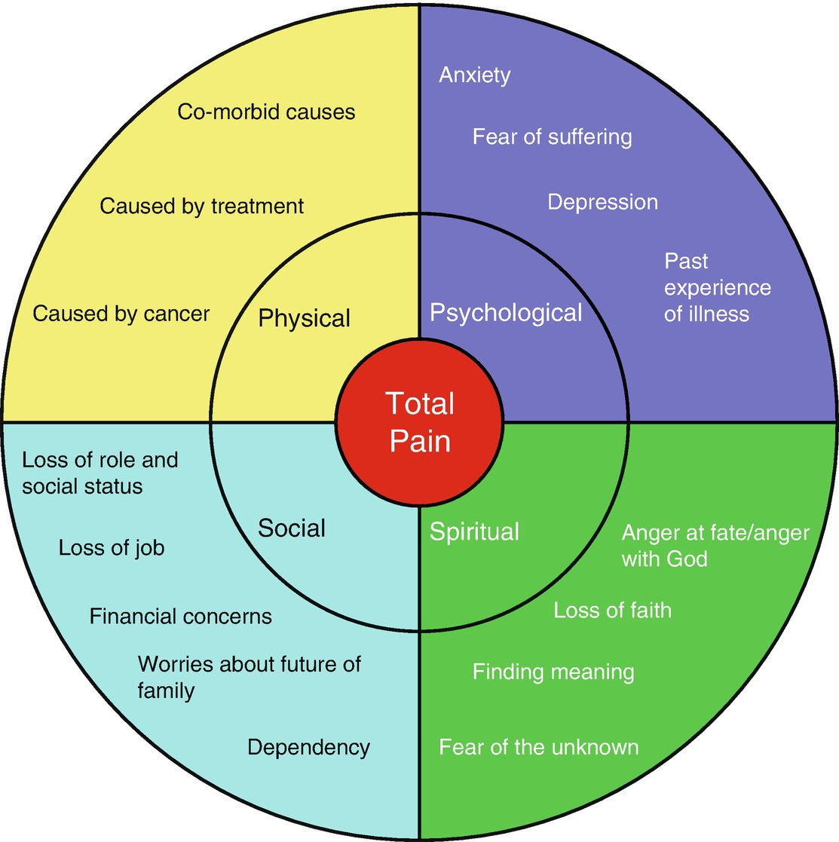

Slide 43
Body posture
Actions
Mobility
Verbal responses
Facial expressions
Emotions
Accompanying symptoms
Physical changes
Identifying the person in pain

Slide 44
What can you do?
Calm & confident approach
Don’t wait for the patient to complain – observe
Positioning
Companionship/listening
Touch – comforting or massage/rubbing
Heat/cold
Distraction
Imagery & Relaxation
Alternative therapies
Psychological support – mood/anxiety
Drugs are only part of the overall management
When given drugs – do they work?

Slide 45
Patient/carer misconceptions
Healthcare professional misconceptions
Morphine myths and fears
Poor prescribing
Poor administration
Failure to diagnose cause of pain correctly
Lack of awareness and confidence of healthcare professional
Reasons for unrelieved pain

Slide 46
Morphine myths and misconceptions
What does morphine mean to you?
Strong analgesic
?Addiction
?Tolerance
?Hasten death
Side effects

Slide 47
Assessment
The key to effective pain management.
Verbal V.A.S
Patient Pain Diary
Pain Scale 0-10
Mild, moderate, severe
P.Q.R.S.T.U.V. (Twycross)
All of these involve spending time with the patient & asking them.
P - palliation or provocation i.e. what makes it better/worse?
Q - quality. Is it sharp, stabbing, hot etc
R - radiation. Where does it spread?
S - severity (mild, moderate, severe)
Has it been this bad/like this before?
T - time/temporal (when did it start?Constant/variable)
U - unique to the individual (not specific to diagnosis or disease
V - variable, depending on many factors e.g. mood, fatigue, morale

Slide 48
Step 1
- paracetamol
- NSAIDs e.g. diclofenac, ibuprofen
Step two
Given when non-opioids are no longer effective
Should be added to non-opioid NOT substituted for one
Laxatives will be needed
There is no value in using an alternative weak opioid for continuing pain (except from specific drug intolerance)
Step three
Should not be feared
Respiratory depression & addiction are NOT a problem
Used when weak opioids are no longer effective
Oral morphine is the global strong opioid
Oxycodone, Alfentanil

Slide 49
Other treatments
Corticosteroids e.g. dexamethasone
Anti-depressants
Antispasmodics
Muscle relaxants
Antimuscarinics
Anaesthetic agents
Surgery
Radiotherapy
Bisphosphonates
Epidural/Intrathecal
TENS
Complimentary therapies
Counselling/Psychotherapy
Distraction
Modification of lifestyle & environment

Slide 50
Edna is 82 she has been married to Frank for 56 years. Frank was 80 this year. They have 4 children, two of whom live nearby. Edna was diagnosed with dementia 3 years ago; she also has COPD and Parkinson's disease.
Up to recently Frank cared for Edna at home with help from family, neighbors and three times daily career calls. But Edna was admitted into hospital 5 days ago, with increased confusion and a chest infection, her infection has been treated but she remains confused is agitated at times and has now needs LTOT, it is now also difficult to communicate with her.
The decision has been made that Edna is now dying and recognising dying paperwork has been completed. Edna is showing signs of pain, agitation, SOB and secretions.
How would you manage Edna's symptoms?

